Slide 1
Treasurer Reporting Procedures
For LWML Groups and Societies

Slide 2
Report basics
The heading of your report should include:
Group or Society name
Title of Report
Time period of the report
The footer should include:
Name of Meeting
Type of Report
Date of Meeting

Slide 3
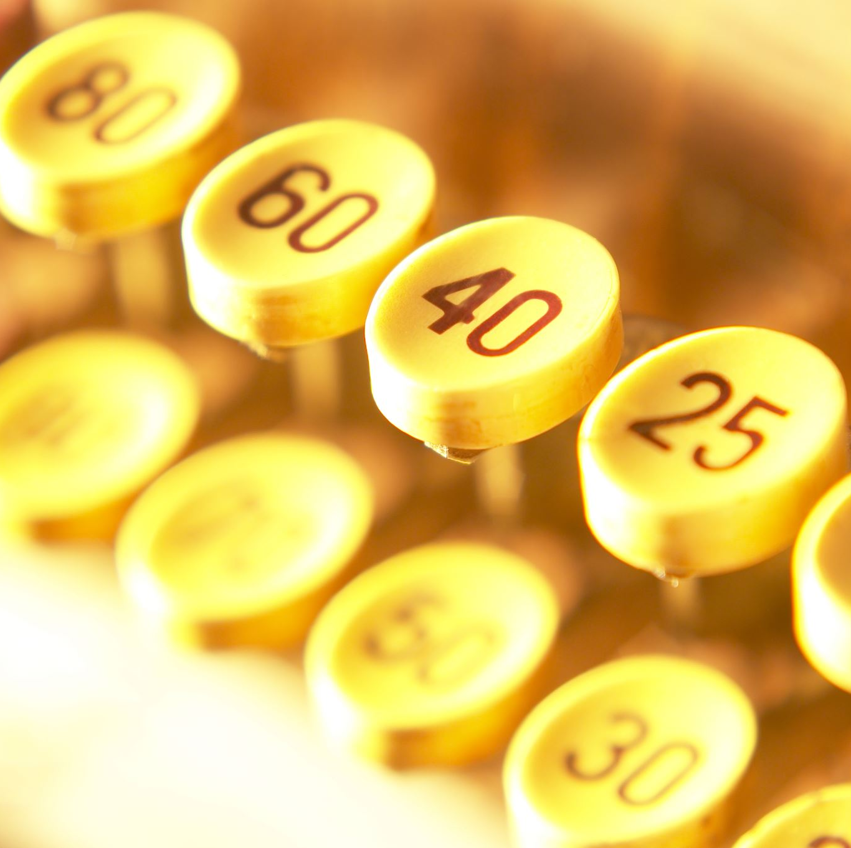
Bank accounts
All monies received should be deposited into the bank account held by your group.
Shop for a bank with either no fees and low minimum balances.
Checks should not be printed with an address on them since this changes with each new treasurer.
Address of the account should be updated to ensure the bank statements are received timely.

Slide 4
Some basic requirements of treasurers and financial officers:
• Be acquainted with the financial structure and policies of the LWML (National, District, Zone, Group);
• Read your bylaws;
• Have knowledge of bookkeeping and banking procedures;
• Have the ability to reconcile the monthly bank statement; and
• Be accurate, methodical, organized, and prompt.
Treasurer Reports are filed for financial review.

Slide 5
Additional Standard Practices
Segregate duties.
Let everyone know the rules and/or policies that are in place and make sure everyone follows the rules all the time.
Establish clear responsibilities.
Physically protect cash and the checkbook.
When cash is involved have two people count the cash together.
Reconcile the bank statement.

Slide 6
Bank Accounts
All bank accounts should be opened using the LWML Atlantic District Federal Identification number is 23-7540639
All checks should require two signatures to be negotiated.
Bank accounts should be named as follows:
LWML Atlantic District-
Society Name

Slide 7
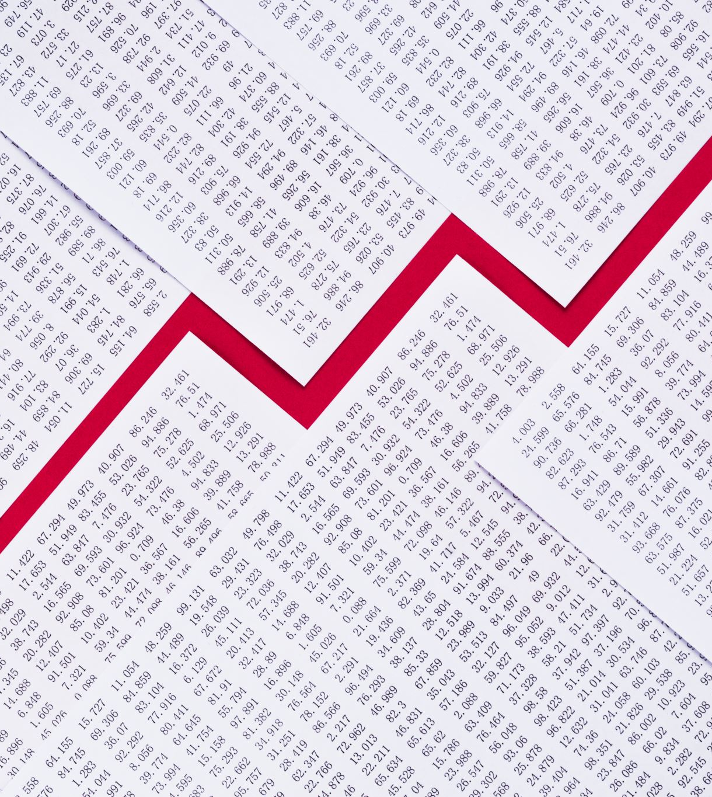
Income
All money received should be deposited into the group’s bank account.
Deposits are listed on the report by date

Slide 8
Disbursements
List all payments including date, check number, payee, amount and reason for payment

Slide 9
Opening and closing balance on report
The opening balance shown on the report should be the same as the closing balance on the most previous report.
Bank accounts should be reconciled each month. Any discrepancies should be investigated as soon as possible.

Slide 10
Sample Treasurer’s Report

Slide 11
Thank you for your willingness to serve as the Treasurer of your LWML group!
May God bless you as you use your God-given gifts to serve with gladness!

